Slide 1


With great Parsl comes great portability:
Using Parsl through CytoTable
for harmonizing single-cell data
+
=
➡️⚙️❤️

Slide 2
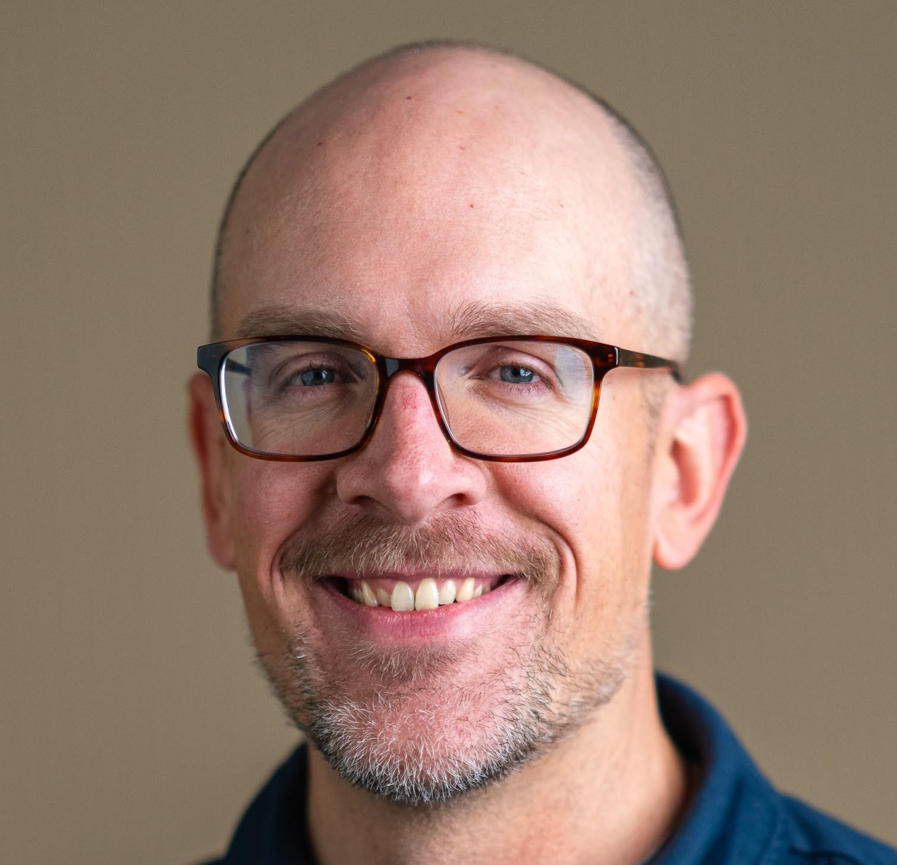


Introduction
Dave Bunten
Principal Research
Software Engineer
Department of
Biomedical Informatics
University of Colorado
Anschutz Medical Campus
School of Medicine
Way Lab (Gregory P. Way)

Slide 3
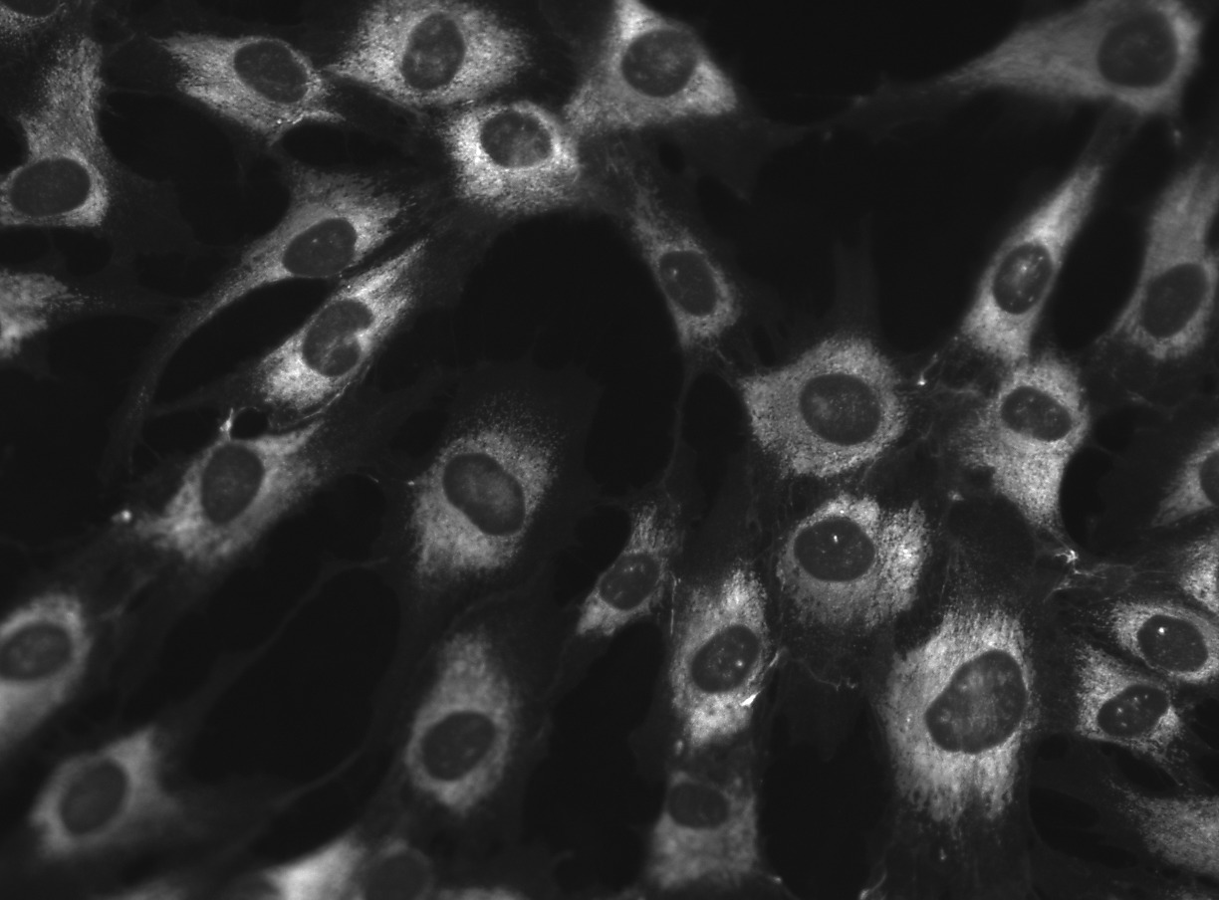
Background
Bioinformatics:
Image-based profiling
Images of cells
to numeric data
(1000’s of features)
💾
💾
💾
Images: Tomkinson et al., Plate 2 (Cell Painting images from Plate 2 for NF1_cellpainting_data project), 2023.

Slide 4
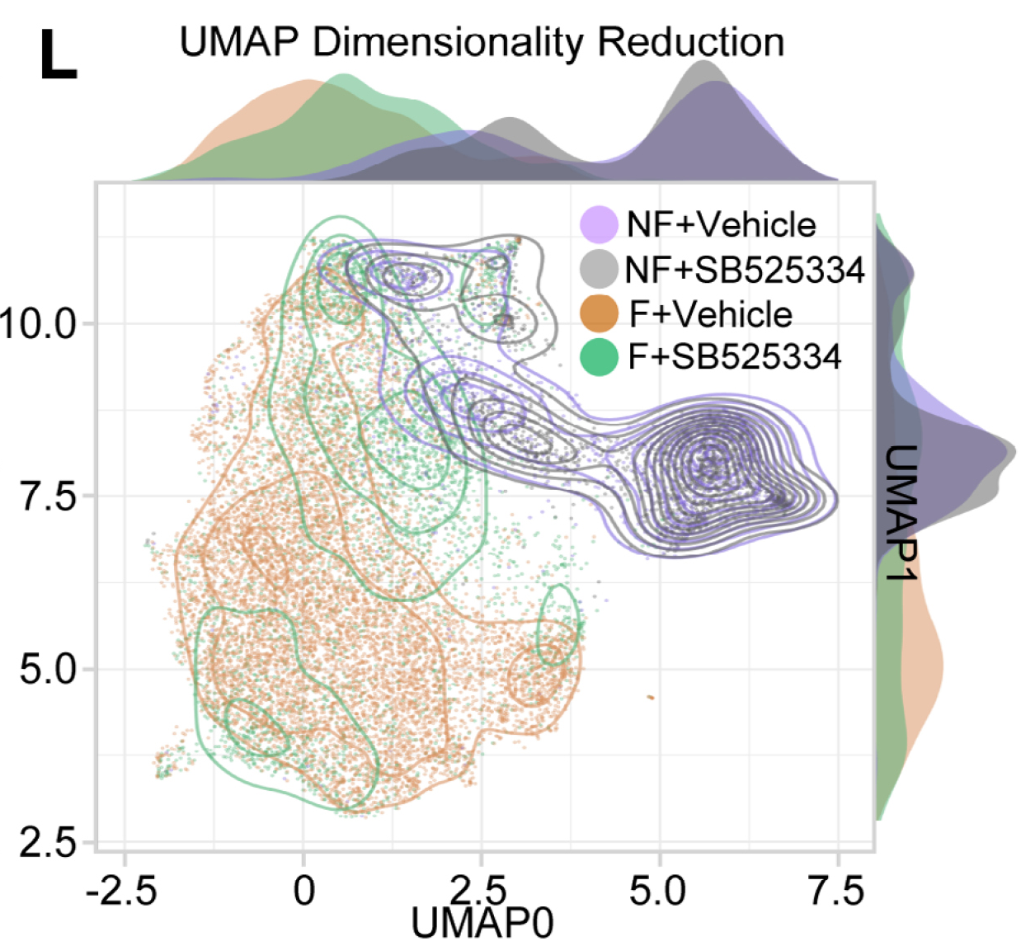
Why?
Data derived from images
help us understand
biological phenomena.
Information is used to
help cure diseases
and improve lives.
Images are cost-effective
to produce.
(Travers et al., 2025, Cell Painting and Machine Learning Distinguish Fibroblasts From Nonfailing and Failing Human Hearts)

Slide 5
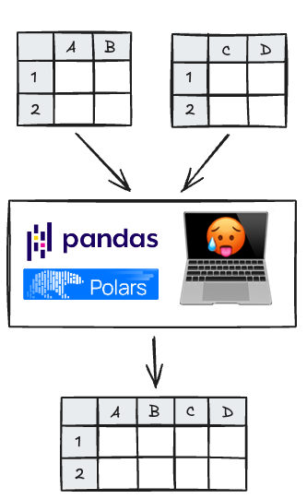
Challenge
Merging data is expensive
and expressed differently
in DataFrame libraries.
Single-cell feature data
entail many different
schema and file formats
from various ecosystems
and microscopy products.

Slide 6
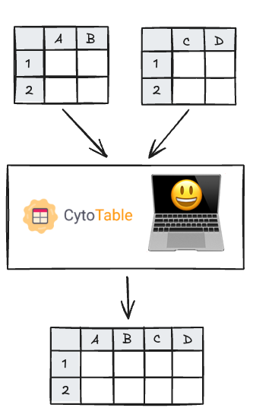
Solution
CytoTable addresses these
challenges through scalable
data harmonization.
“[Data harmonization is] …
the practice of combining
different datasets to maximize
their comparability
or compatibility”
(Cheng et al., 2024)

Slide 7
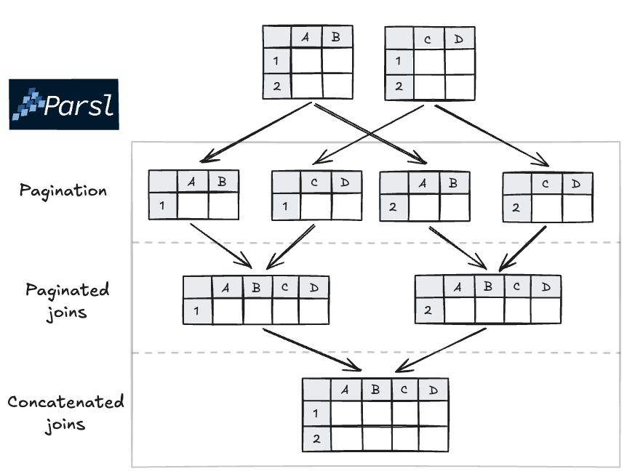
CytoTable + Parsl
CytoTable uses Parsl to
orchestrate paginated
data harmonization.
We implement map-reduce through
paginated maps and concatenated reduction.

Slide 8
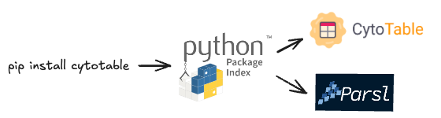

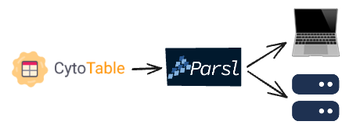
Portability + scale (!)
CytoTable is managed using
PyPI packages, including Parsl.
Parsl config within CytoTable includes defaults with
flexibility for overrides.
Parsl is compatible with HPC,
reducing compute barriers.

Slide 9
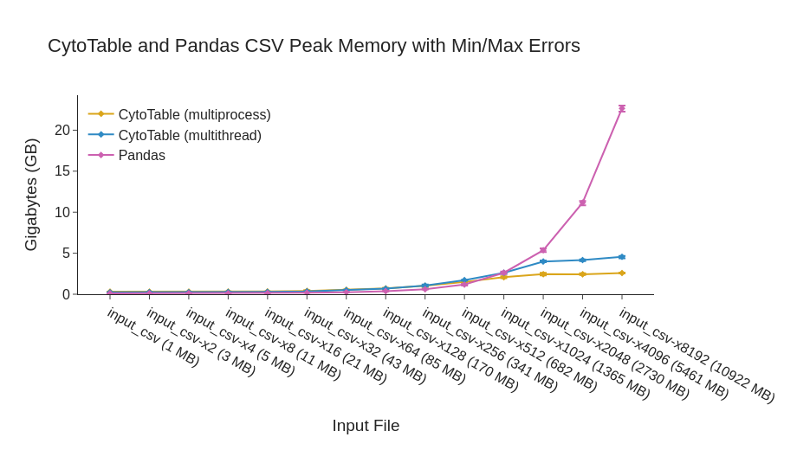
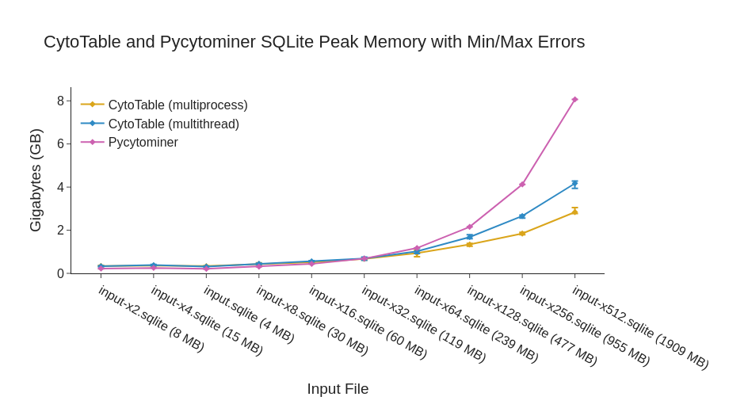
Solutions at Scale
We find that CytoTable enables scalable memory and time performance when compared to existing methods.

Slide 10
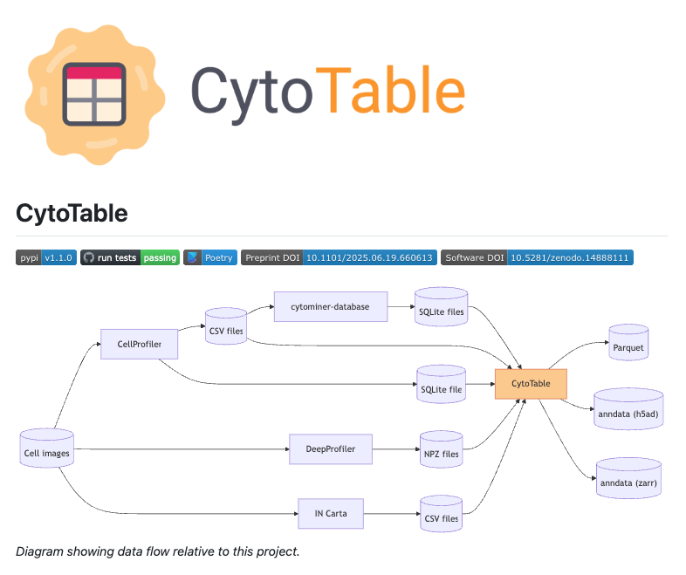
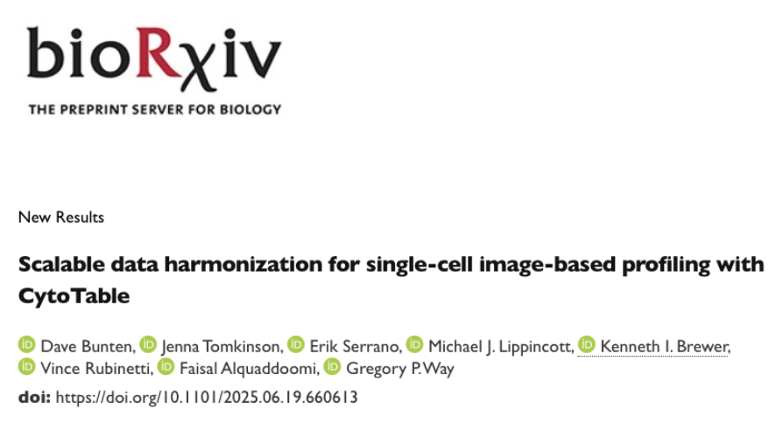
Thank you!
Questions/comments?
Find more here!
Preprint: https://www.biorxiv.org/content/10.1101/2025.06.19.660613v1
GitHub repository:
https://github.com/cytomining/CytoTable

